Slide 1
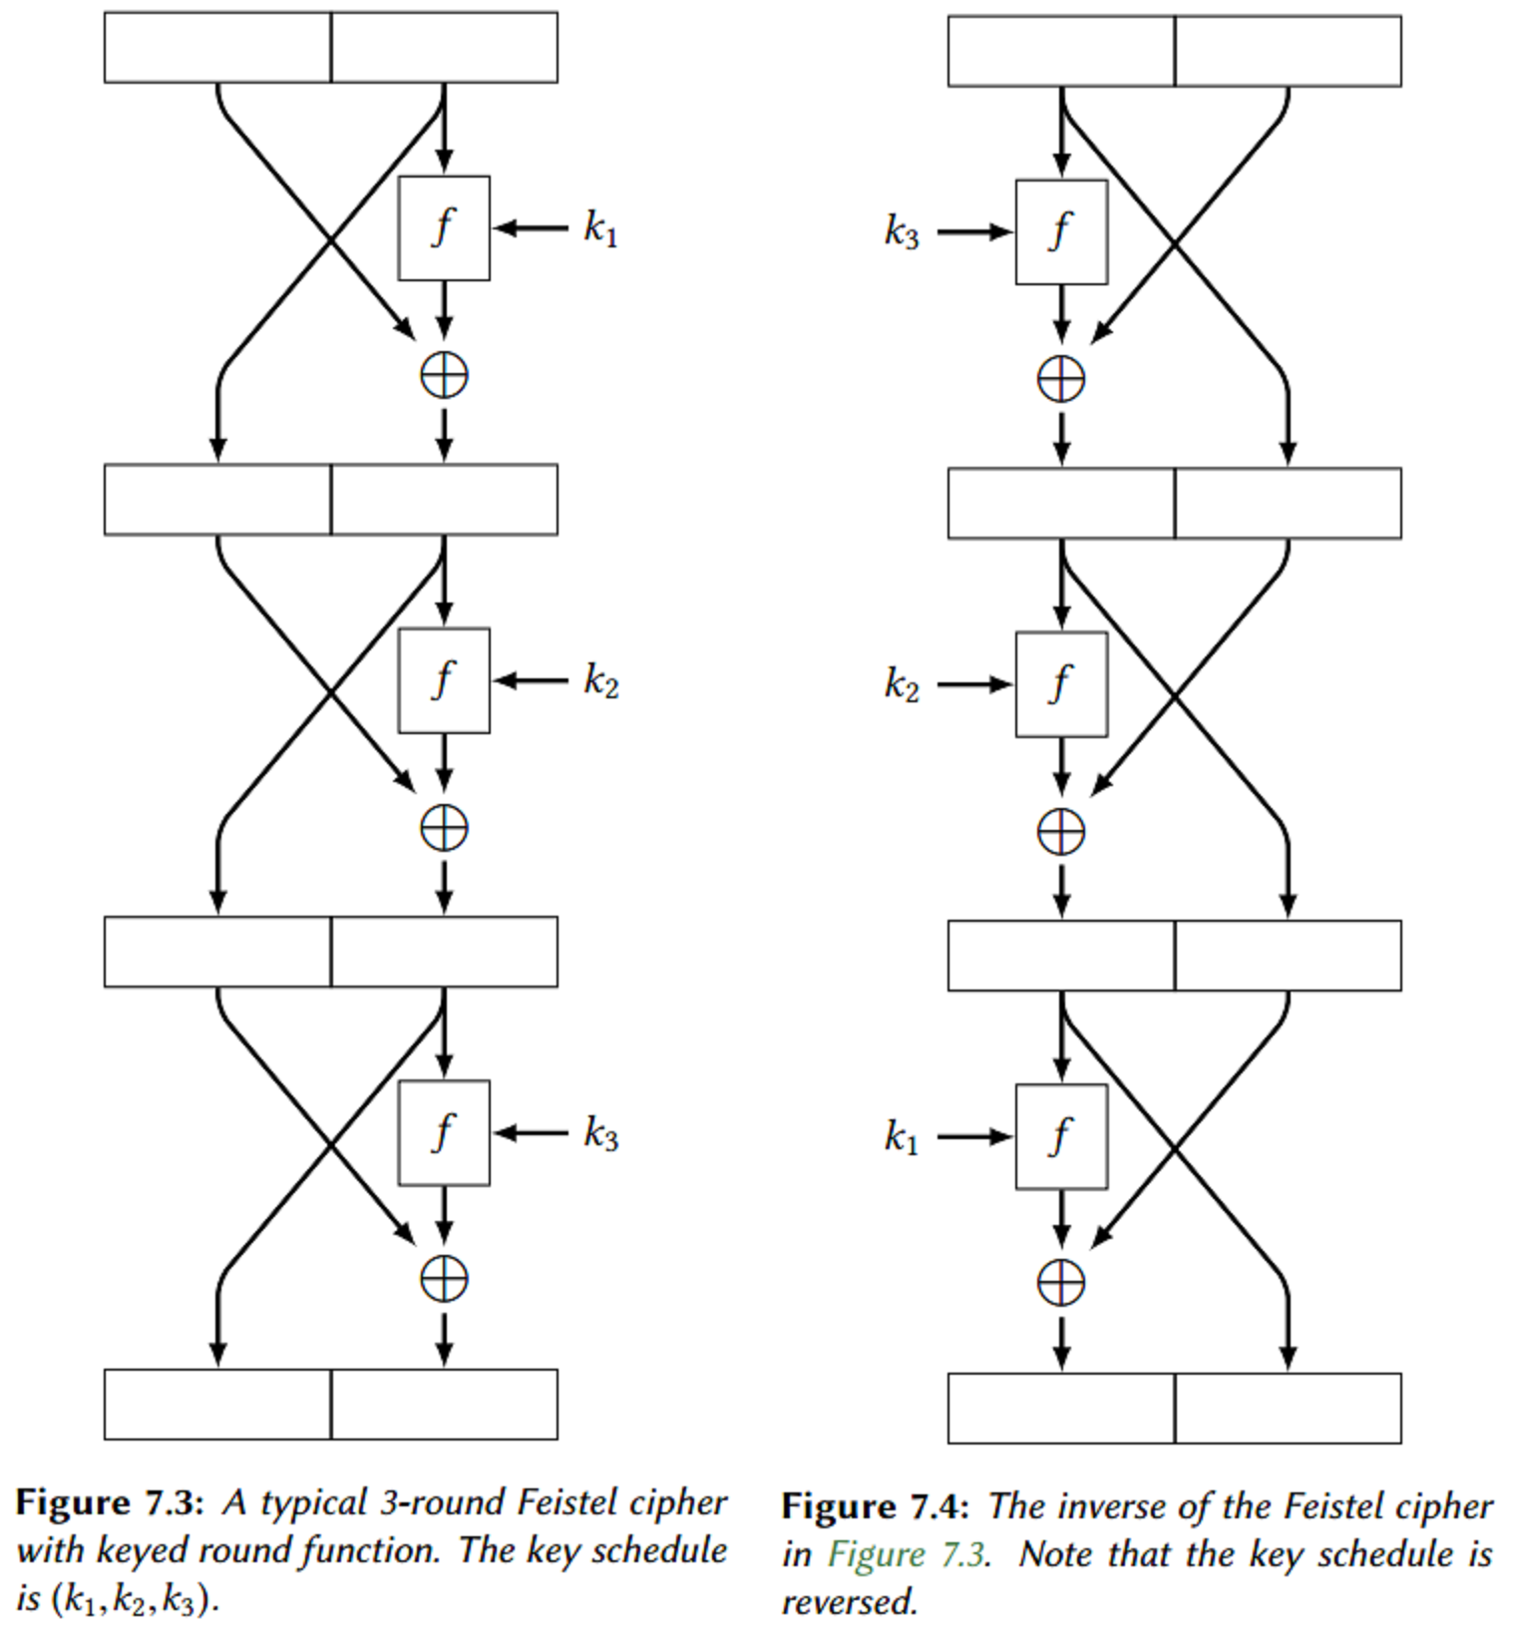
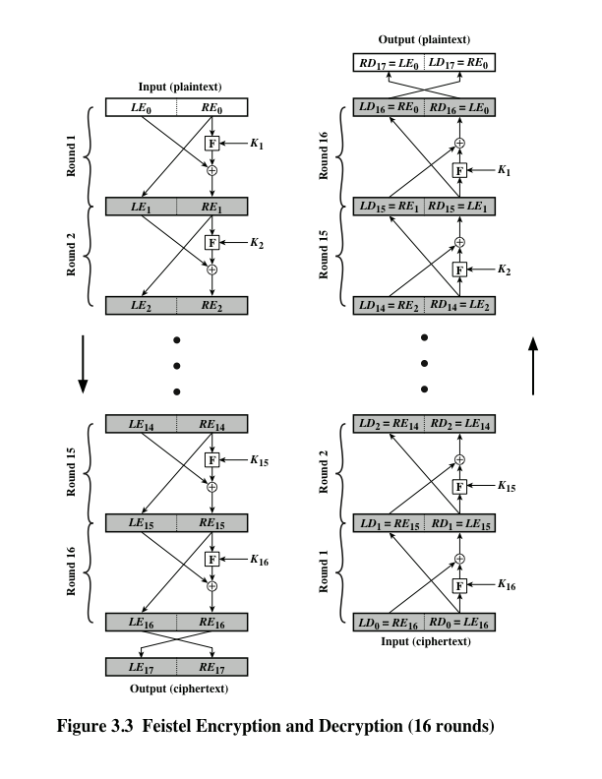
Feistel Cipher Structure
}
{
transposition
substitution
{
Transposition
Cycle transposition
move bits 32 places
}
Substitution
Vigenère Autokey System

Slide 2
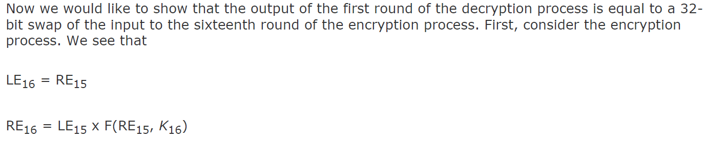
FEISTAL EXAMPLE

Slide 3
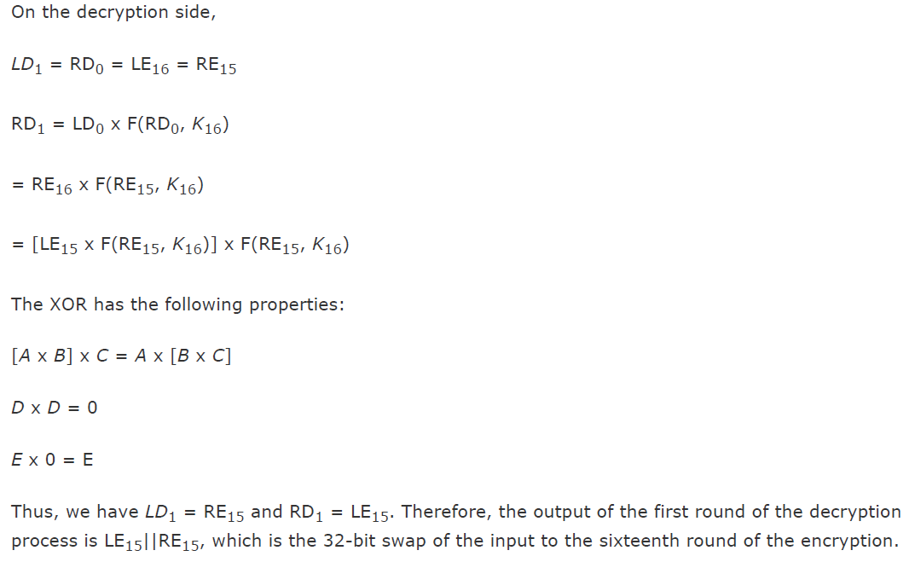
FEISTAL EXAMPLE

